Slide 1
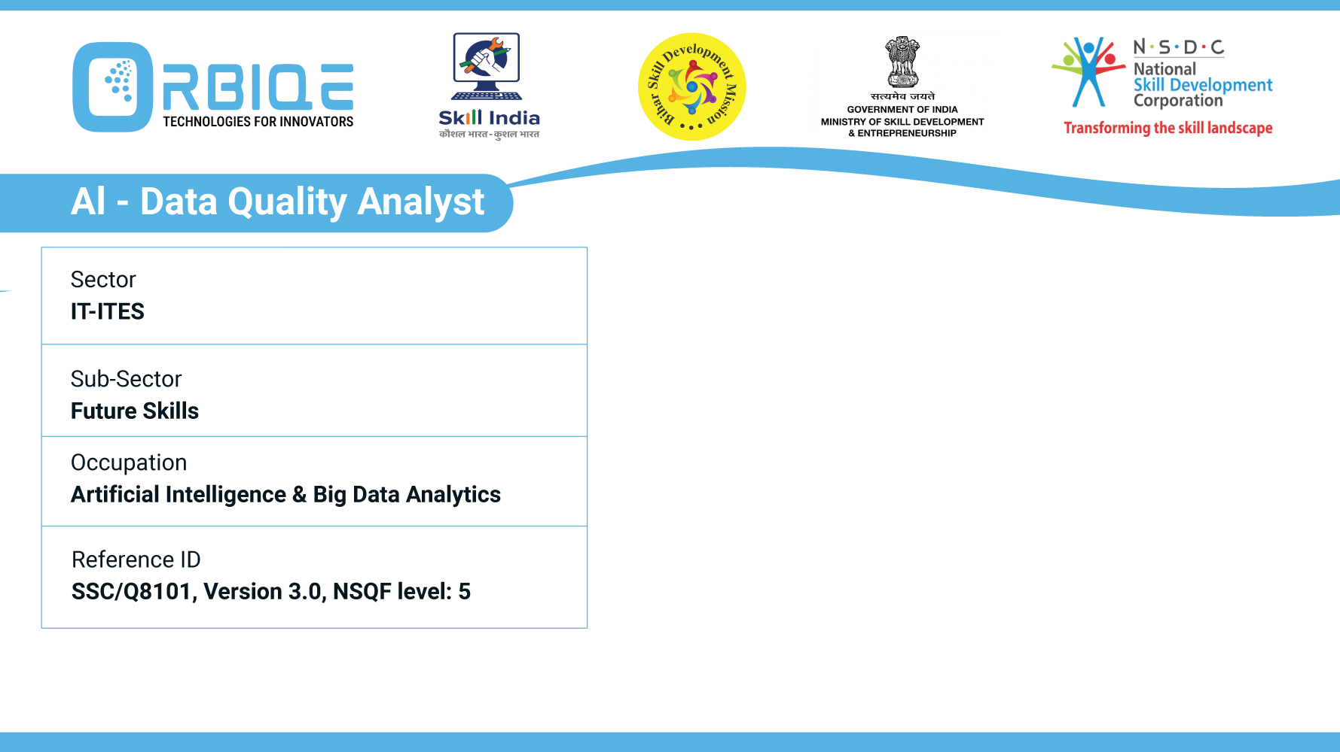
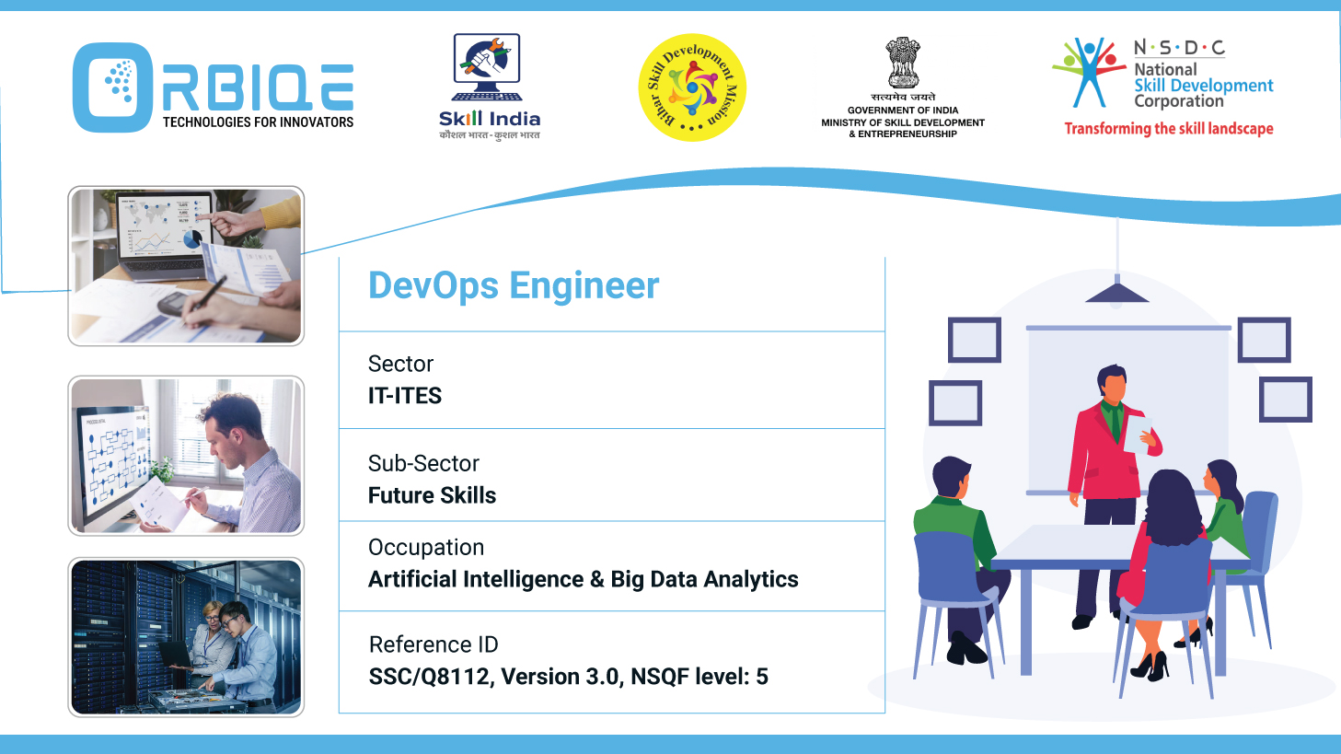
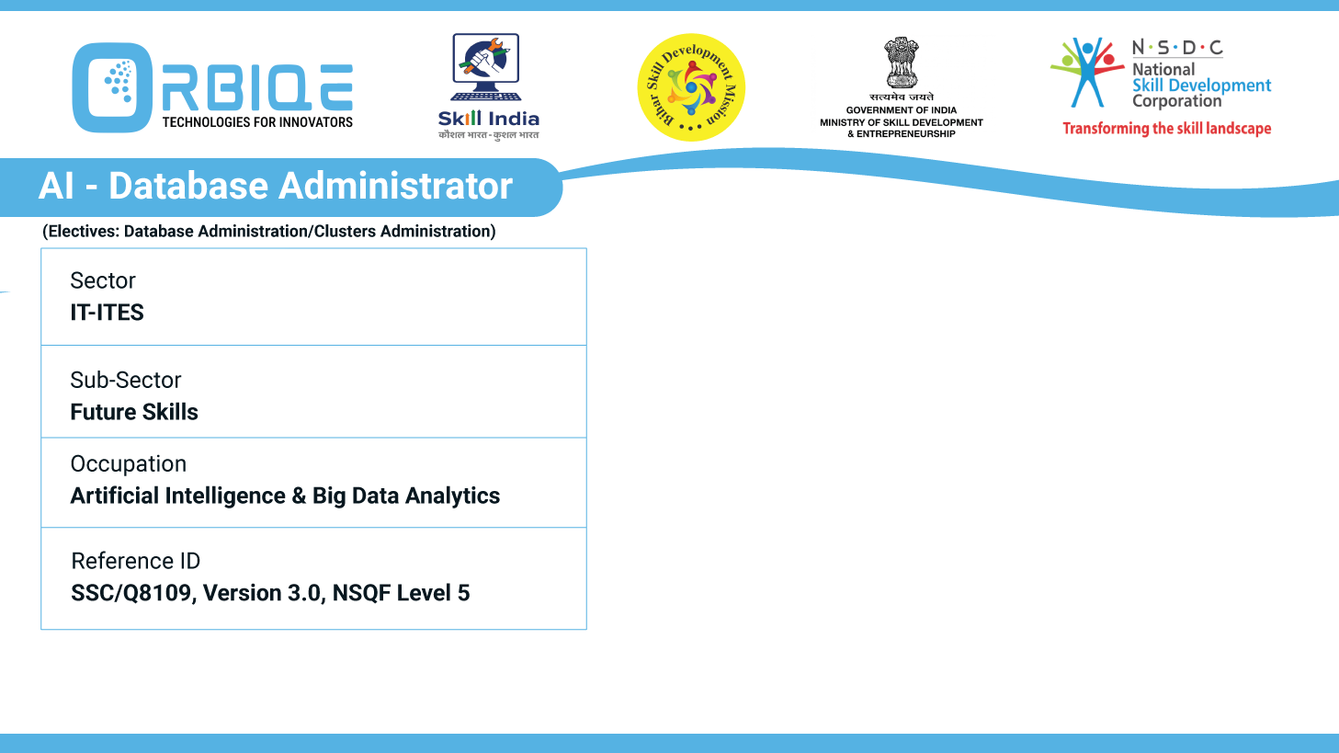
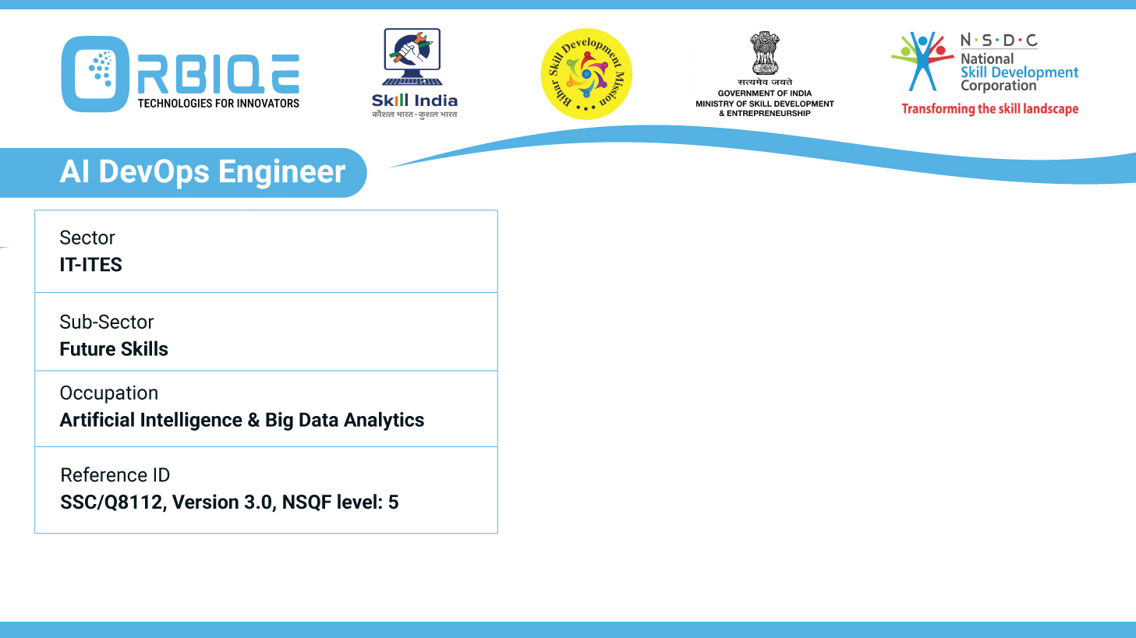
Name- Krishna Kant Dubey

Slide 2

AI and Big Data in Society

Slide 3
Agenda
Understand the societal impact of AI and Big Data Analytics
How these technologies contribute to advancements in various aspects of life, economy, and innovation

Slide 4
Understand the societal impact of AI and Big Data Analytics

Slide 5
How these technologies contribute to advancements in various aspects of life, economy, and innovation

Slide 6
Thank You

